Slide 1


Slide 2
TEAM
Lebogang Modau
Mandisa Majozi
Nwabisa Ndodana

Slide 3



Slide 4
“821 million people go to bed hungry every night all over the world, chronically hungry, and as the new Global Report on Food Crisis published today shows, there are a further 135 million people facing crisis levels of hunger or worse.
But now the World Food Programme analysis shows that, due to the Coronavirus, an additional 130 million people could be pushed to the brink of starvation by the end of 2020.” - David Beasley, UN World Food Programme (WFP) Executive Director

Slide 5
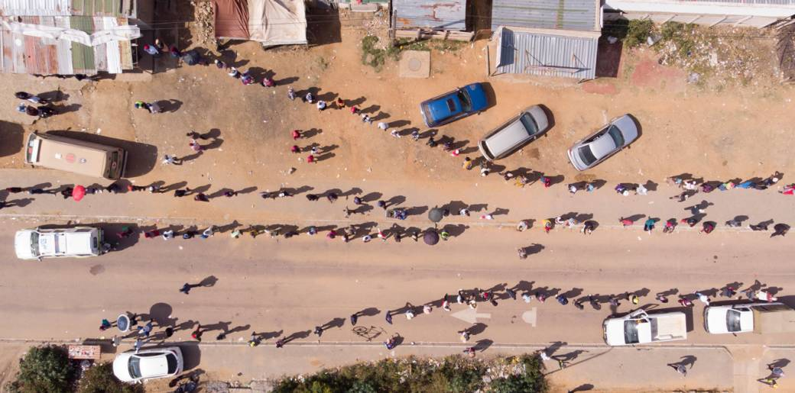
Is the problem well defined?
Queues of up to 4km long in the Centurion townships of Olievenhoutbosch and Mooiplaas as over thousands of residents stood in line for food parcels on 2 May. (Source: AFP)

Slide 6
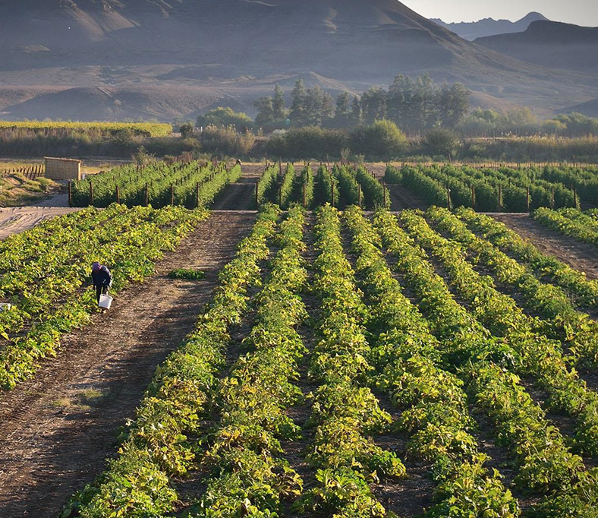
PROBLEM STATEMENT
SA
Most food secure country in Africa
is 44th out of 133 countries worldwide
-Economist Intelligence Unit's 2017 Global Food Security Index

Slide 7
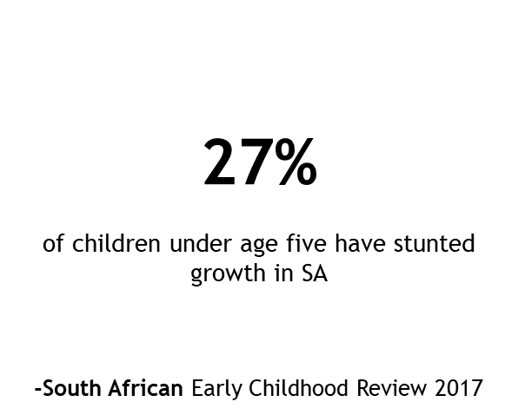
PROBLEM STATEMENT

Slide 8
PROBLEM STATEMENT
SA currently has a 30.1% unemployment rate which results in people struggling to feed themselves and their families.
Markets have over priced food and barriers to the farming and food production market, thus making it difficult for people to manufacture the own goods in a large scale and leading them to buy expensive food.

Slide 9
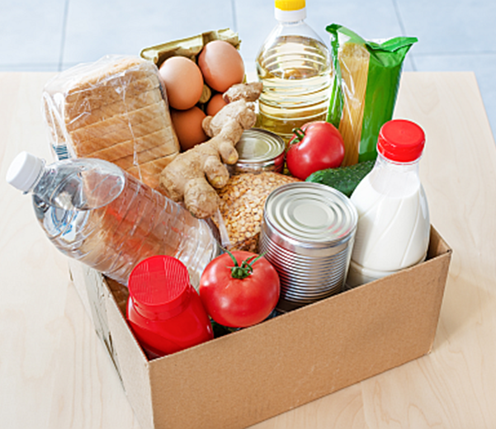
PROBLEM STATEMENT
Government's initial short-term pandemic emergency response was to increase financial assistance to the most vulnerable in society:
By increasing grant payments that put cash into the pockets of the hungry was the most straightforward short-term solution. As well as hand out food parcels. This is not sustainable in the long-term.

Slide 10
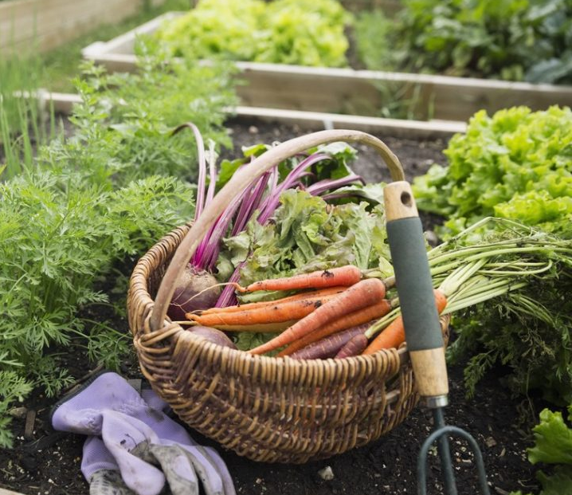
OUR SOLUTION

Slide 11
OUR SOLUTION
A web app that teaches people how to do vegetable and poultry farming in their own yards.
This will help and guide people on how to successfully create their home farm, tend to it and obtain successful harvests.
The app will include a locator side where you can search and connect with other users near you to trade or sell goods to each other.

Slide 12
OUR SOLUTION
This can create job opportunities and income and food for many homes and communities.
Future feature add-ons: The app will have page where you are given advice on packaging for you products should you wish to sell them, recipes for goods grown and rewards for app usage, trade or money made.

Slide 13
DEMO

